Slide 1
BLOCK L: Designing with Light Alloys
Light alloys Presentation 1
In this Block we will use case studies based on:
  Engine Pistons
  Masts for Yachts
  Con Rod
  Hip stem for implants
Exploring:
Design Requirements
Materials selection
Introducing Light alloys (Al, Mg and Ti alloys)
Structure-Properties-Processing interrelationships

Slide 2
Terminology
Light alloys - metals with densities < 4.5 gcm⁻³ and typically lower than 3 gcm⁻³ such as Aluminum and Magnesium characterised by higher specific strength (strength/density ratio) than conventional Fe or Ni based alloys.
Cast - as-cast condition so cooling rate and use of grain refiners key since small grain size improves strength and toughness;
For example Al- 12wt% Si which is the eutectic composition and hence the low T_{m}, and Al-Zn used for die-casting
Wrought products (rolled, extruded, forged); Properties rely on appropriate heat-treatment or working, for example:
age (precipitation) hardened where strength controlled by precipitate distribution, size and coherency;
work hardened: strength from final grain size and defect density.

Slide 3
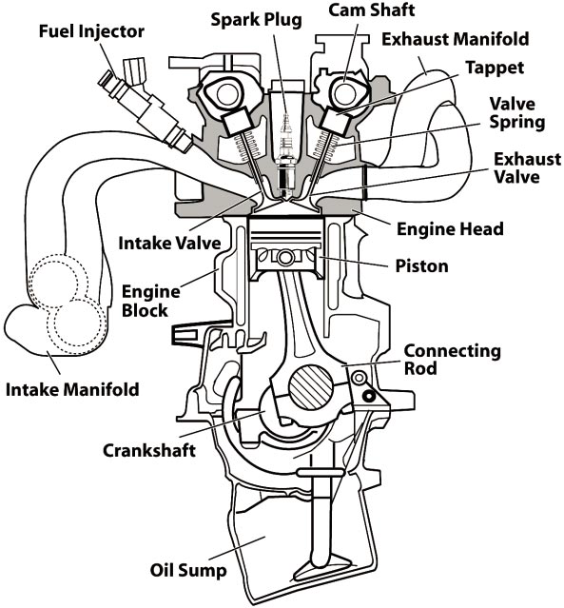
Case study: Piston
Images in this case study are taken from Yamagata, 2005, “The science and engineering of automobile engines”

Slide 4
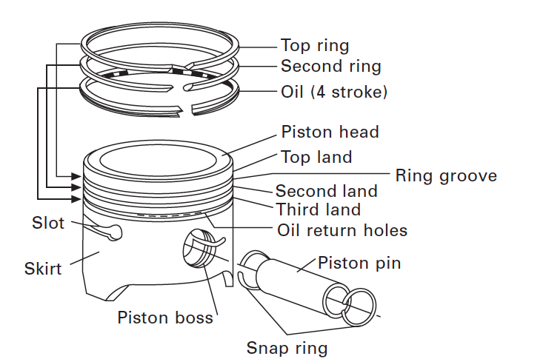
The Piston
The piston pin transmits the forces between the piston and the connecting rod

Slide 5
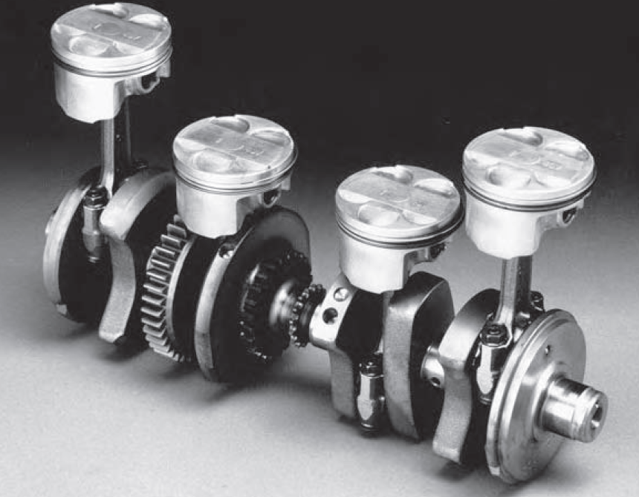
The Piston
Hostile Environment
56 mm piston - 20 kN load - speeds of 15 ms⁻¹.
10⁶ fatigue cycles per hour
The head of the piston 350˚C - Skirt is 150˚C.
Notes:
Comment on how certain design requirements may have similar merit indexes
The piston with the piston rings form a combustion chamber with the cylinder head, sealing the combustion gases. The combustion pressure is transferred to the crankshaft via the piston pin and connecting rod. In two stroke engines the piston act as a valve, exchanging gas.
The piston is subjected to an aggressive environment: For example a 56 mm piston needs to withstand a 20 kN load reaching speeds of 15 ms⁻¹. Assuming an average rpm of 15000 then after only 11 h it has been subjected to 10⁷ fatigue cycles!!! The head of the piston can reach 350˚C while the skirt is 150˚C.
To generate high power output the piston needs to be as light as possible yet still function.
Here we will consider the materials selection for a petrol piston.
( Diesel engines - lower rotation but much higher pressures, 18 MPa).

Slide 6
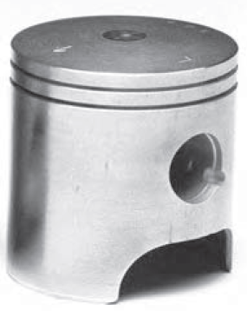
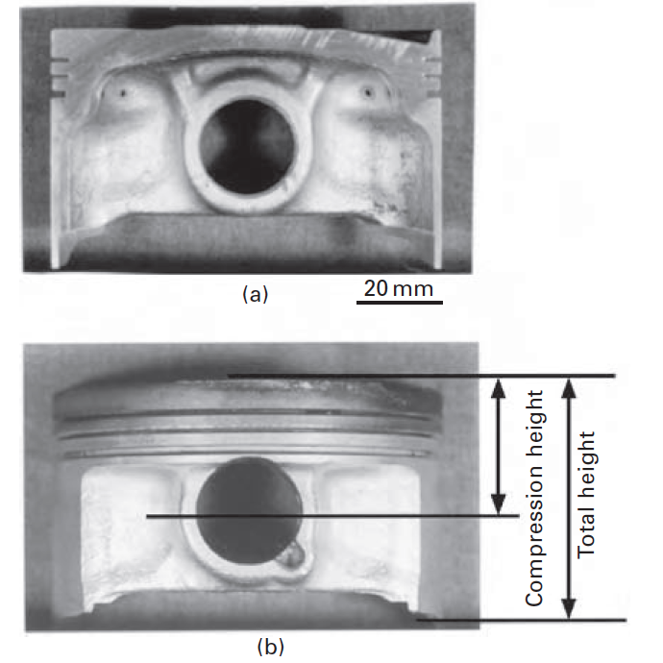
The Piston
Boss - high wear area
4 stroke piston inside(a) and outside (b)
Two stroke piston
Notes:
Discuss with class the difference and why?

Slide 7
Piston considerably cooler than gas
Unburned mixture T_{u}=700K ; Burned mixture T_{b}=2800K.
Surfaces kept cool by the engines cooling system
Burning takes place in only a few crankangle
Source: Dr Antonnio La Rocca, University of Nottingham

Slide 8
Possible desirable properties?
Low thermal expansion
Anti seizure
Wear resistance at ring groove
High thermal conductivity
High creep strength
High fatique strength
High Strength to weight ratio
High fatigue strength at elevated temperatures
Machinability
Low melting point and low viscosity for casting
Capable of near net shape processing
Low cost

Slide 9
The Piston
Function: Forms a combustion chamber by sealing hot gases
Objectives: Transmitting combustion power, allowing gas exchange( two stroke), must also transmit heat from piston head to cylinder wall, must be light for engine efficiency therefore minimise mass
Constraints: Must operate at high temperatures defined by engine type, low thermal expansion, high thermal conductivity, must not seize, high fatigue strength at high T, must be mass produced and low cost
Free variable: Choice of material
There are multiple constraints in any problem, in this case:
high strength to weight ratio
high thermal conductivity with low thermal expansion,
low friction,
strength at operating temperature
low cost.
Notes:
Comment on how certain design requirements may have similar merit indexes

Slide 10
Performance Index
High strength to weight Performance Index:
M₁ = σ_{f}/ρ
High thermal conductivity and low thermal expansion Performance Index:
M₂ = λ/α
M₁ and M₂ are examples of Performance indices
(sometimes called a Merit Index).
The equations are arranged so that optimum performance is obtained with as high a value of M as possible.
Notes:
Comment on how certain design requirements may have similar merit indexes

Slide 11
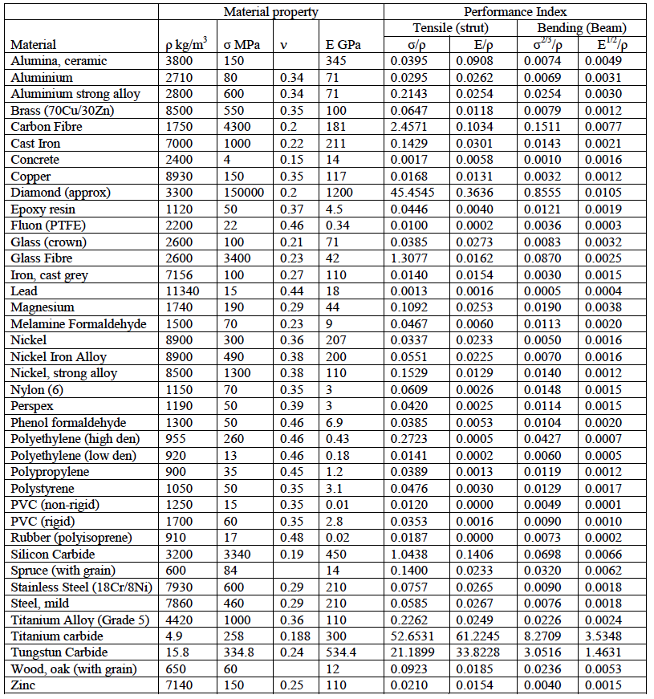
Tabular form
Arranging in tabular from can be useful especially when identifying between a few specific examples
However when exploring materials for design it may be more helpful to plot merit indices graphically….

Slide 12
Performance Index on a graph
Performance index: M₁ = σ_{f}/ρ
Note graph is plotted in logs due to the wide range of material properties and it also helps us to identify the materials selection using the slope
Taking logs then
log M₁ = log σ_{f} – log ρ
Thus
log σ_{f} = 1 x log ρ + log M₁
Which is the form y = mx + c
Therefore plot log σ versus log ρ and lines with slope 1 will have the same performance index.
The desired higher performance index will have higher y intercepts thus by moving line of slope 1 towards top left of graph identification of material which maximises that particular merit index can be found

Slide 13
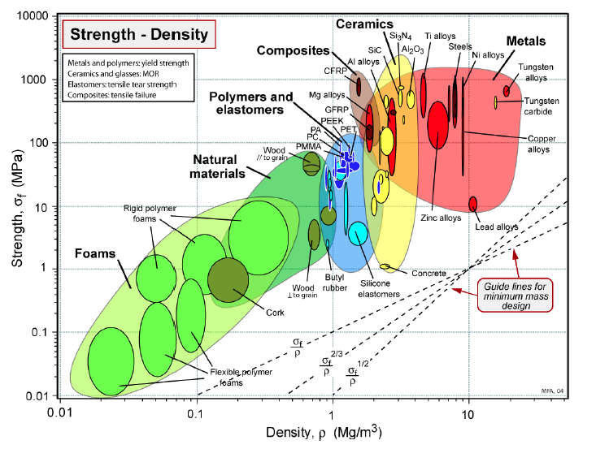
Materials Selection

Slide 14
Materials Selection

Slide 15
Performance Index on a graph
PPerformance index: M₂ = λ/α
Again taking logs then
log M₂ = log λ – log α
Thus
log λ = 1 x log α + log M₂
Which is the form y = mx + c
Again slope 1 will have the same performance index.

Slide 16
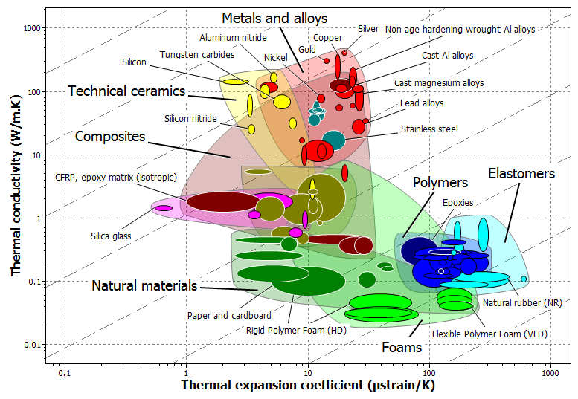

Slide 17
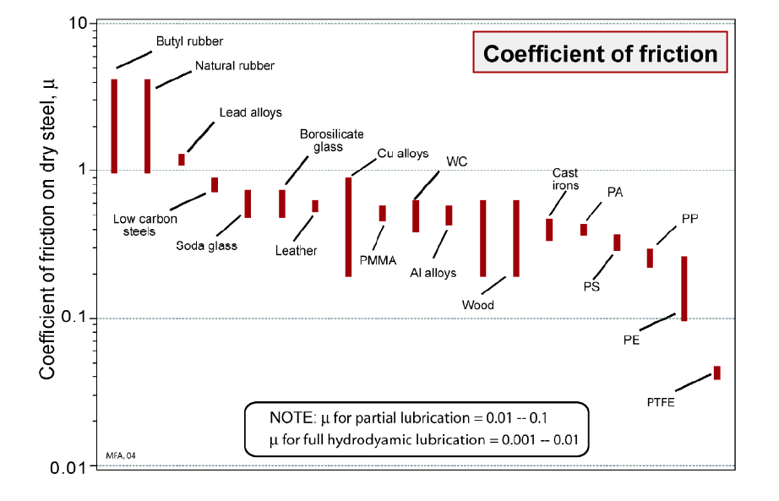
Friction

Slide 18
